Slide 1
Session 5 tEST OF HYPOTHESIS

Slide 2
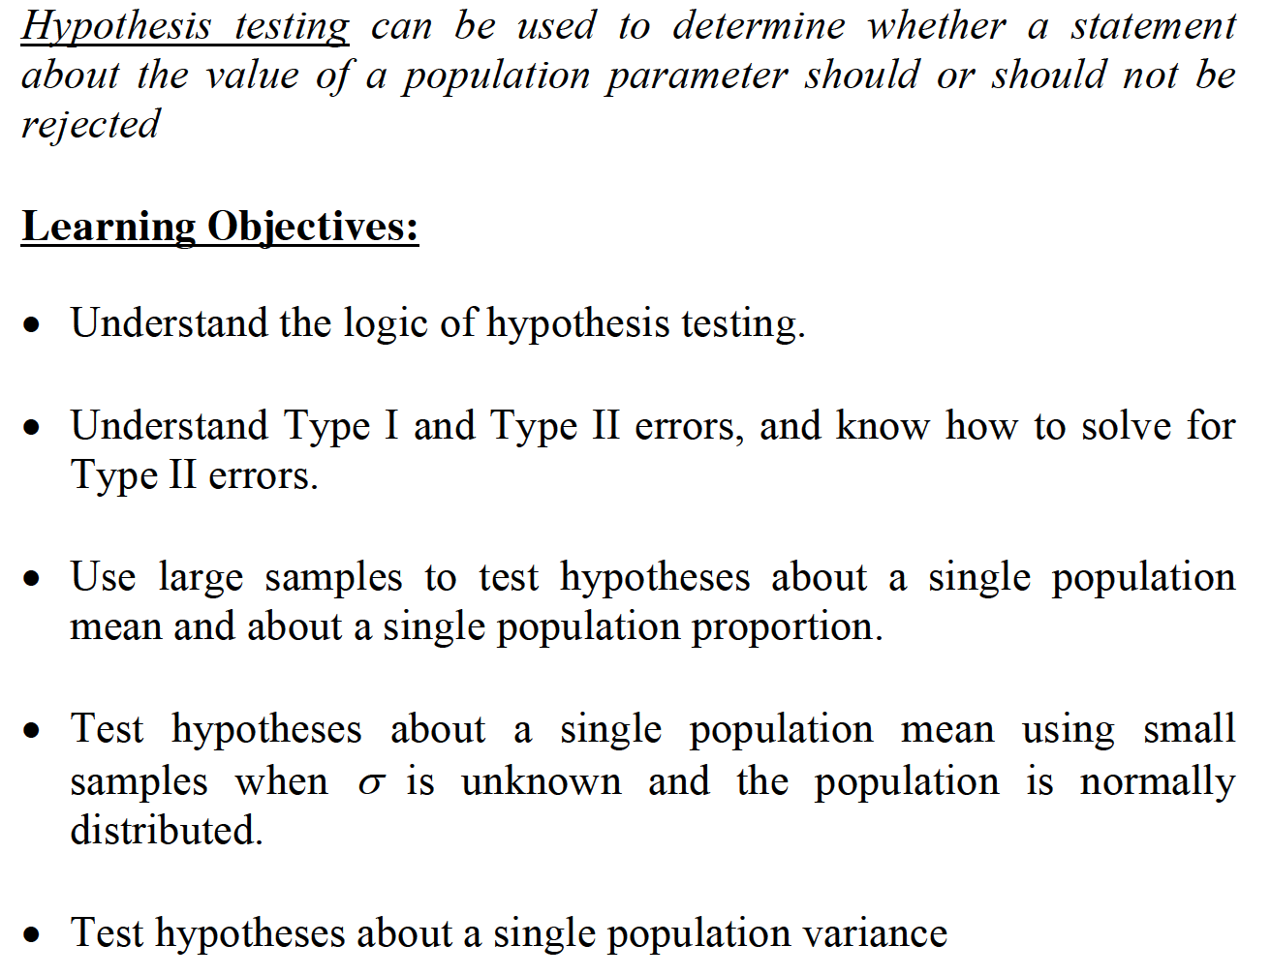
SINGLE SAMPLE

Slide 3
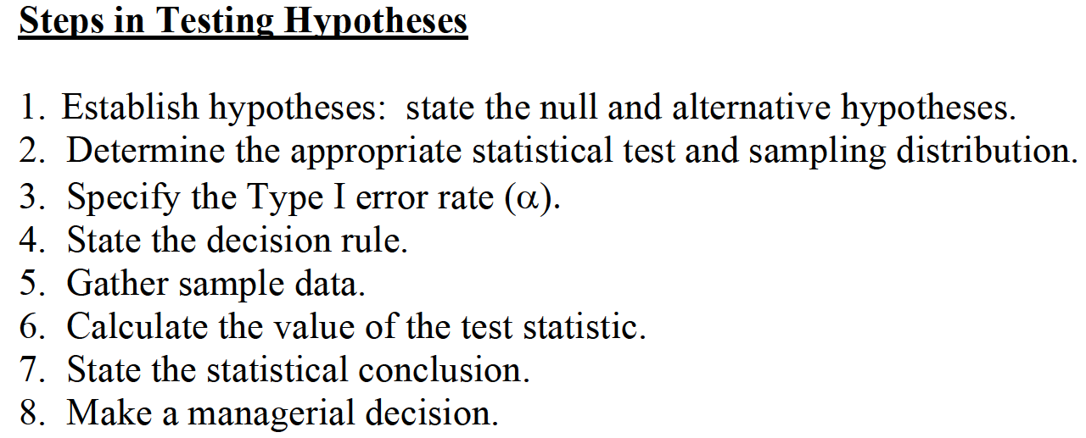
SINGLE SAMPLE

Slide 4

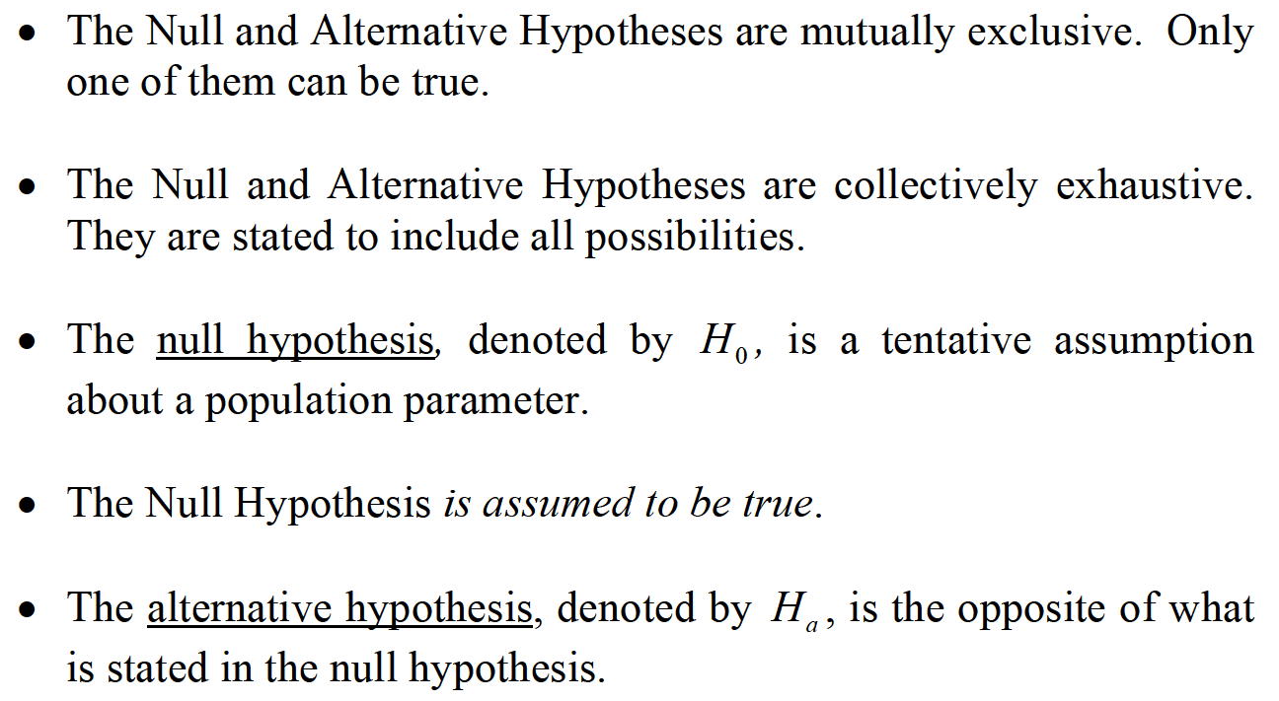
SINGLE SAMPLE

Slide 5
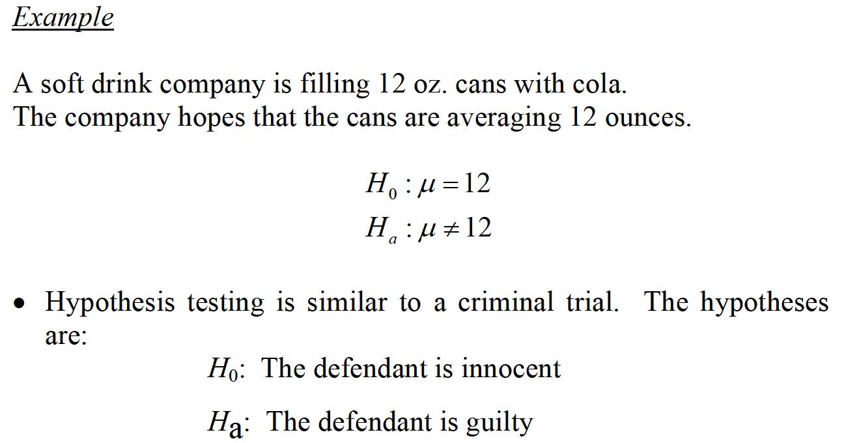
SINGLE SAMPLE

Slide 6
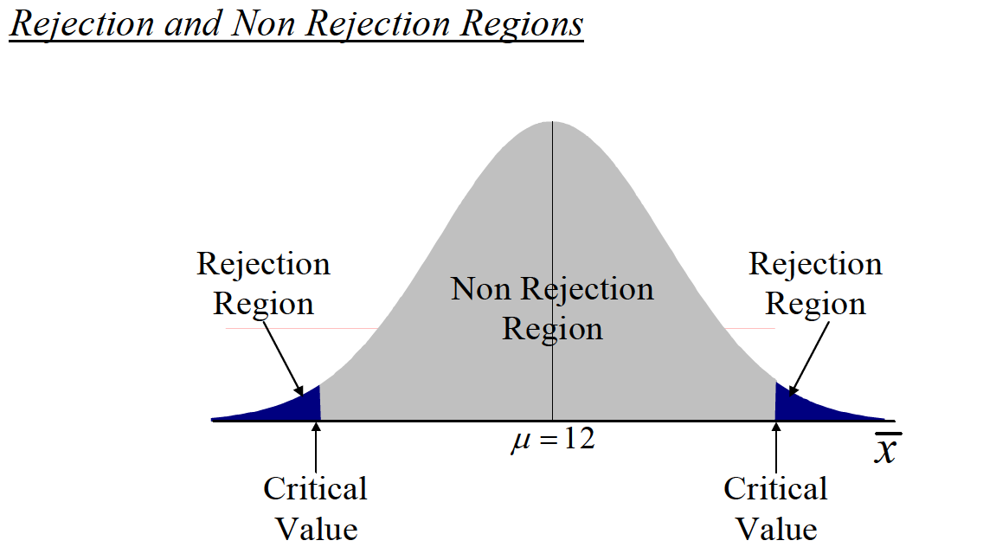
SINGLE SAMPLE

Slide 7
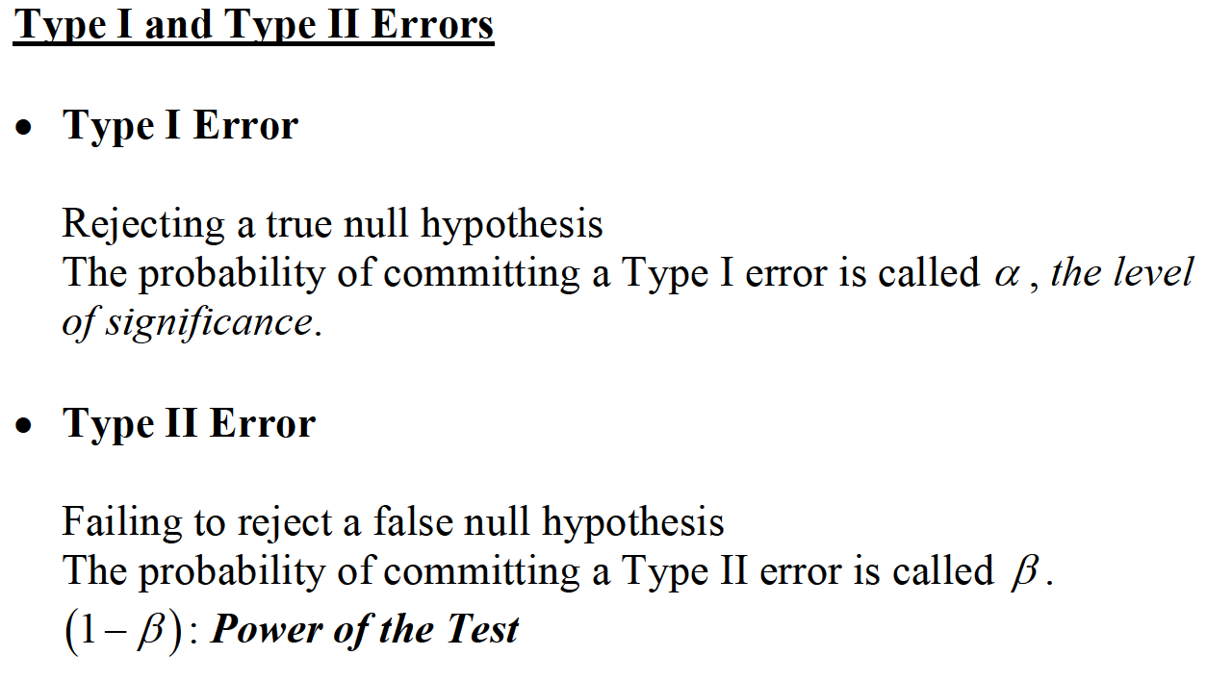
SINGLE SAMPLE

Slide 8
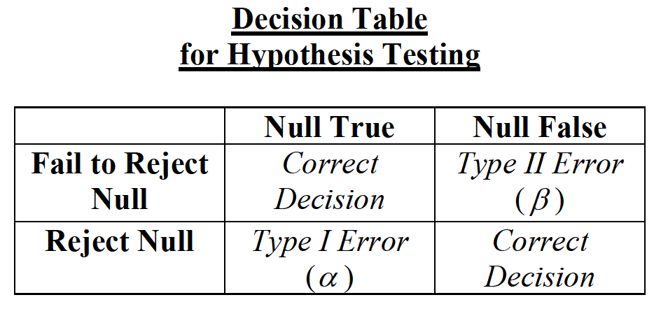
SINGLE SAMPLE

Slide 9
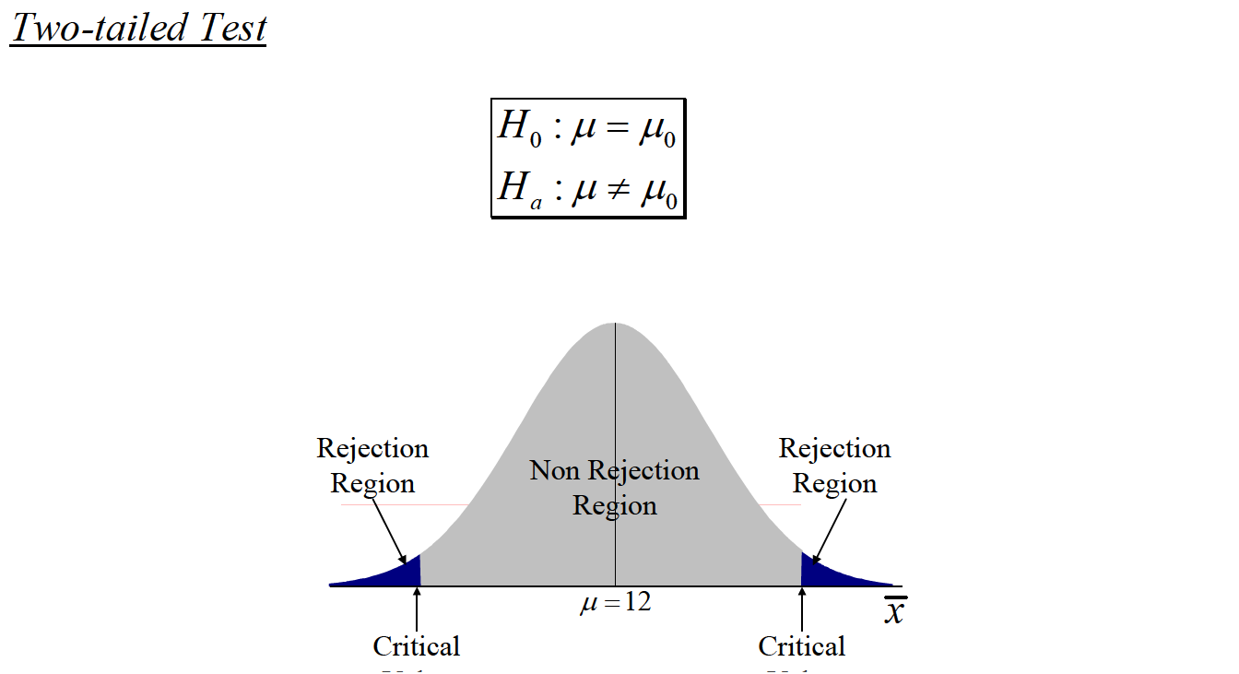
SINGLE SAMPLE

Slide 10
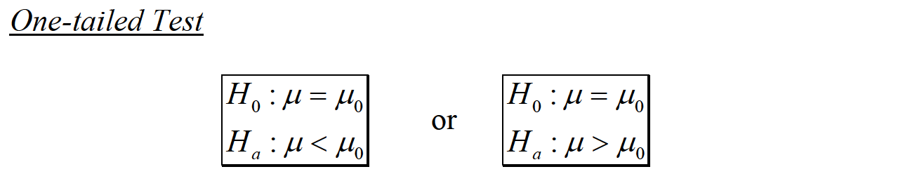
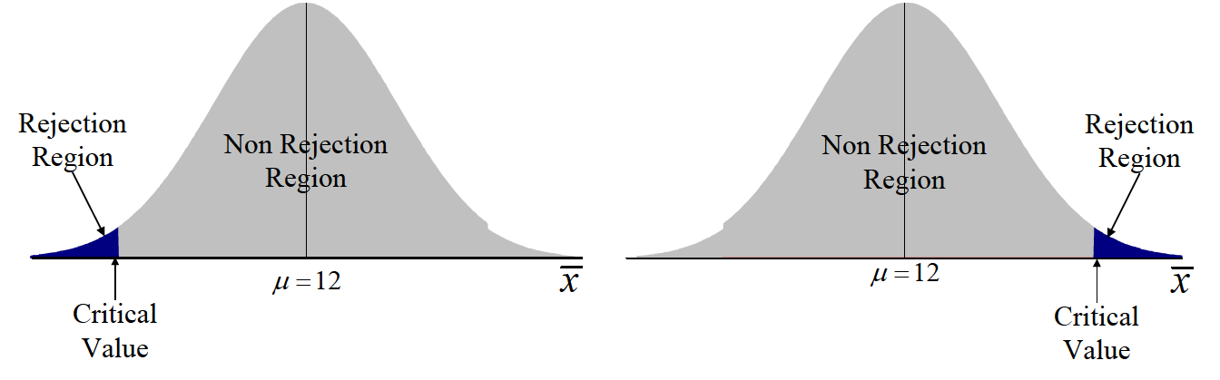
SINGLE SAMPLE

Slide 11
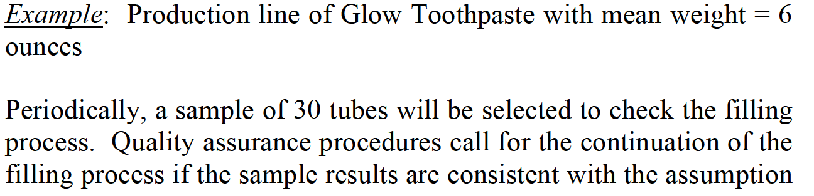
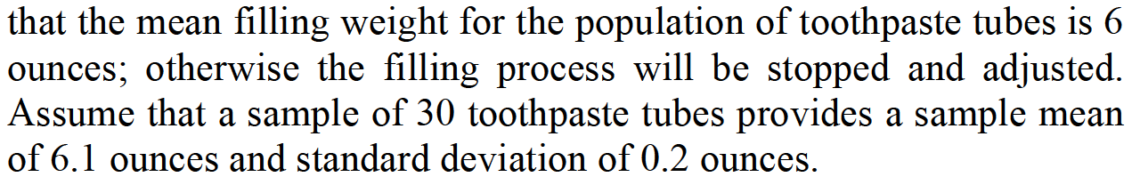
SINGLE SAMPLE

Slide 12
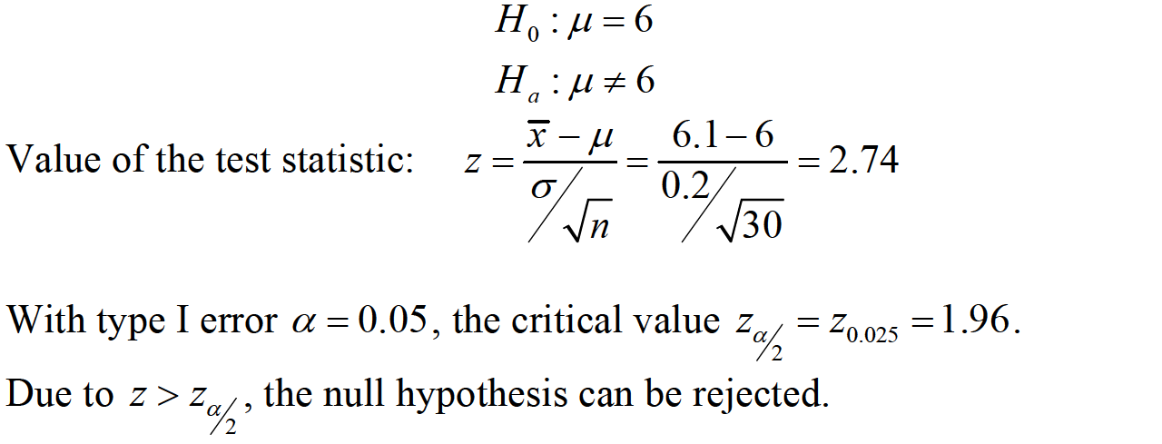
SINGLE SAMPLE

Slide 13

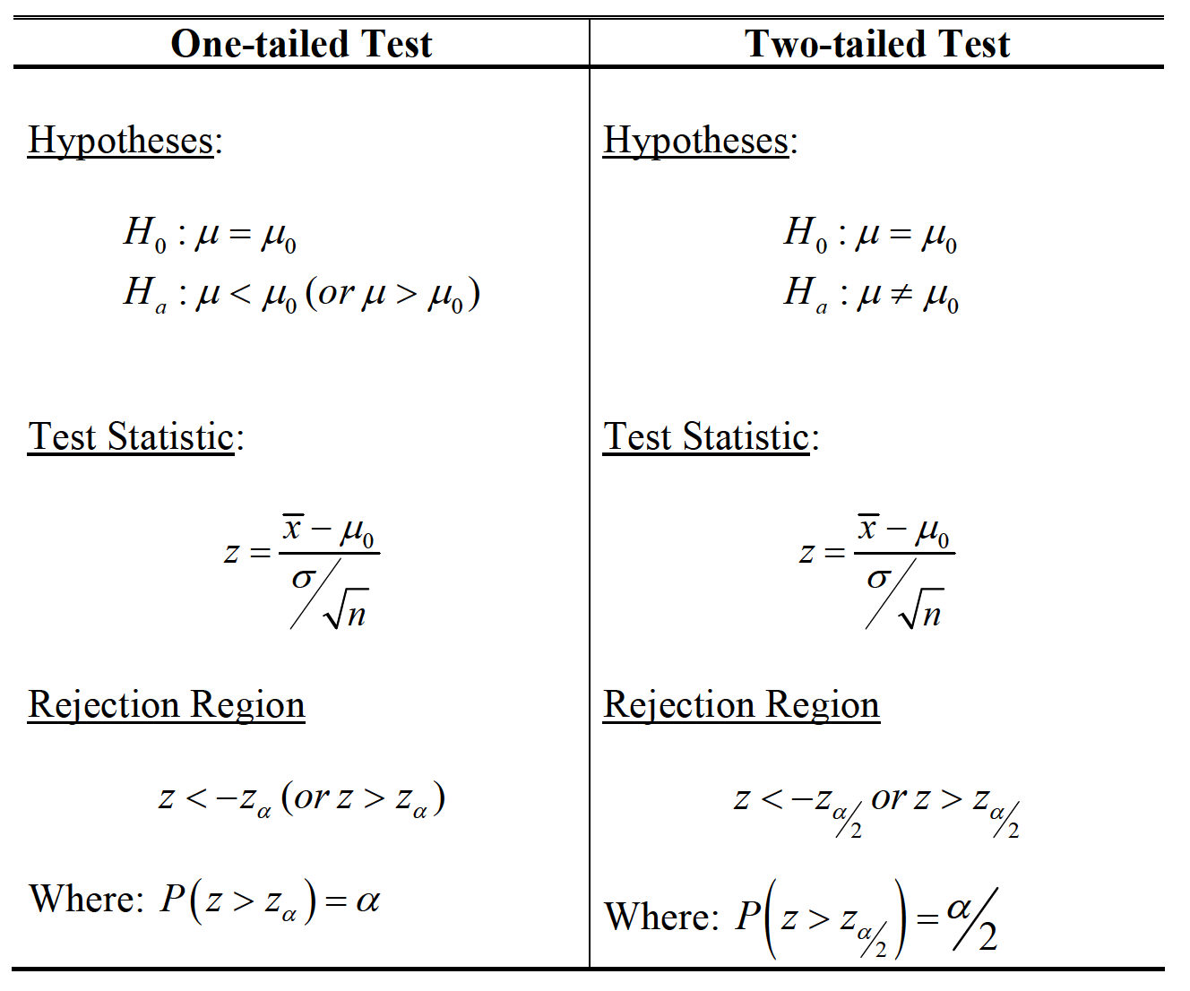
SINGLE SAMPLE

Slide 14

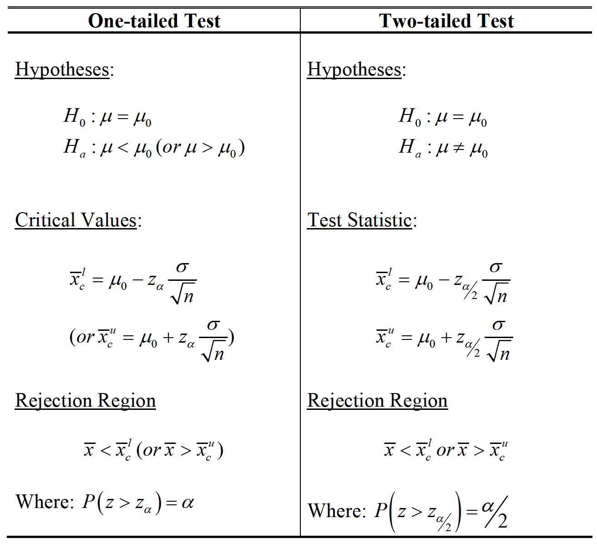
SINGLE SAMPLE

Slide 15
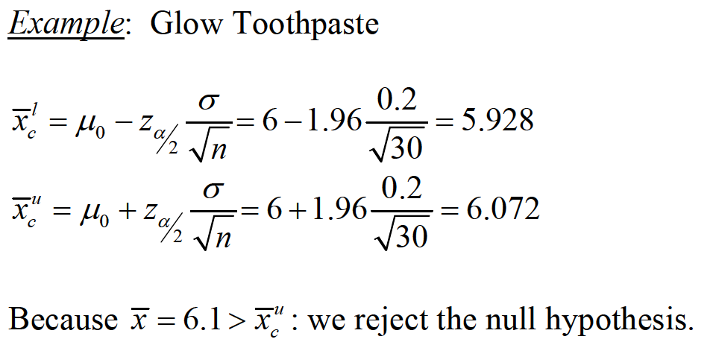
SINGLE SAMPLE

Slide 16

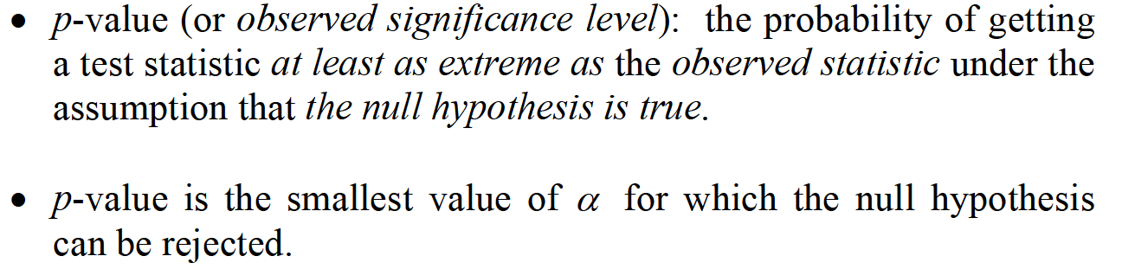
SINGLE SAMPLE

Slide 17
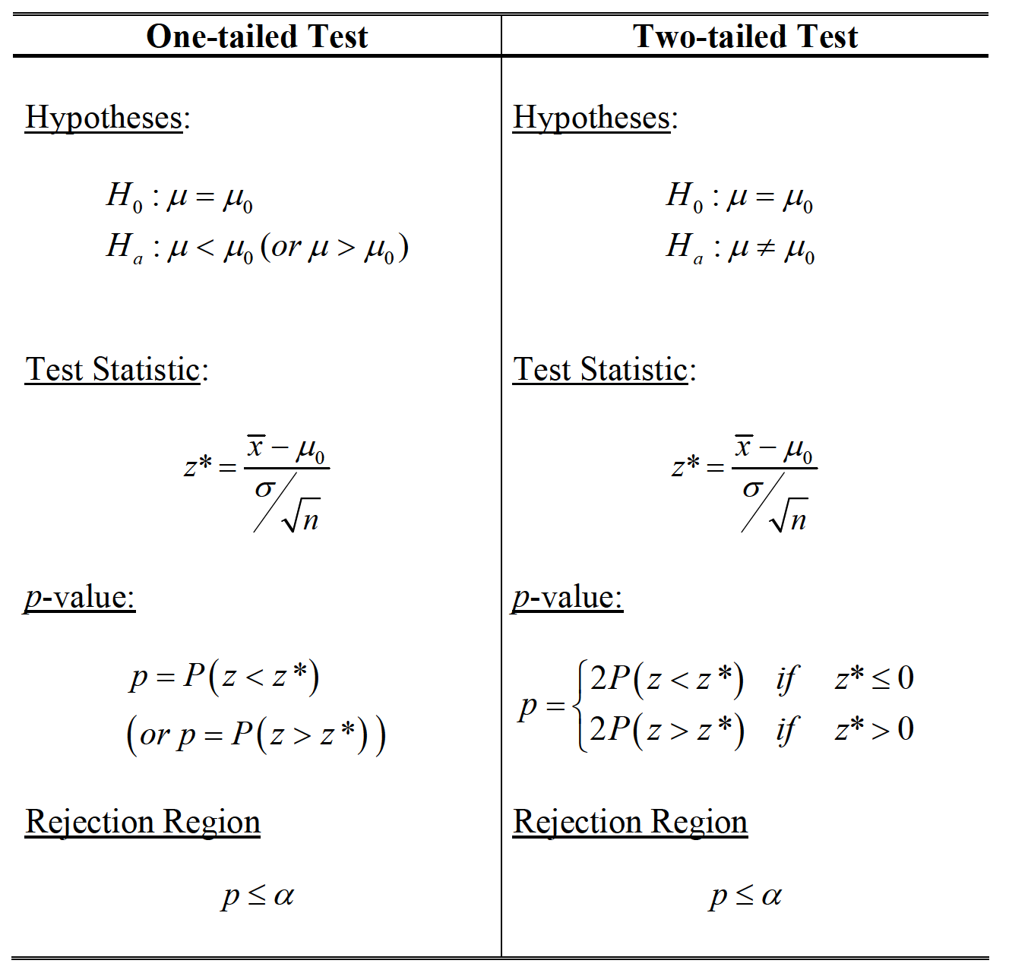
SINGLE SAMPLE

Slide 18
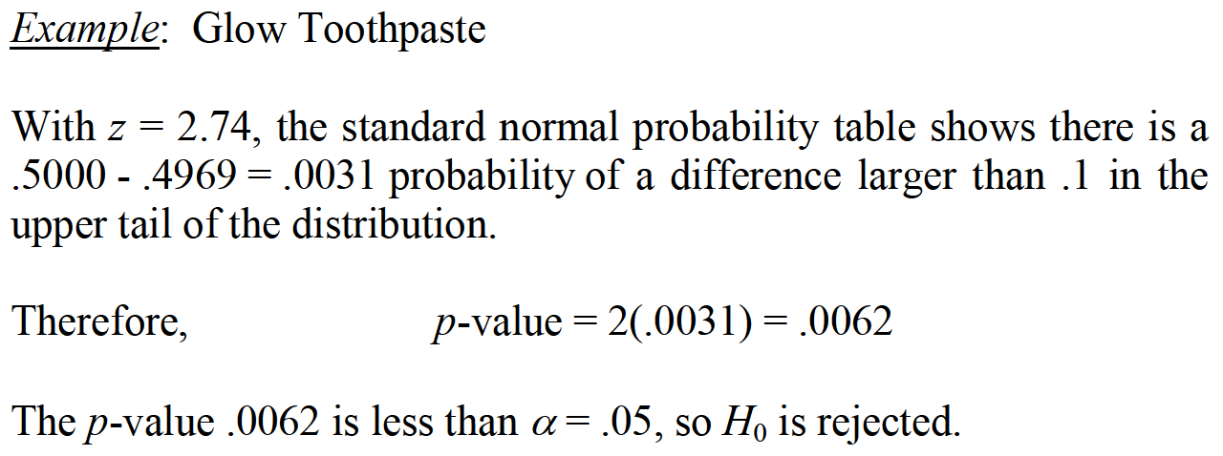
SINGLE SAMPLE

Slide 19
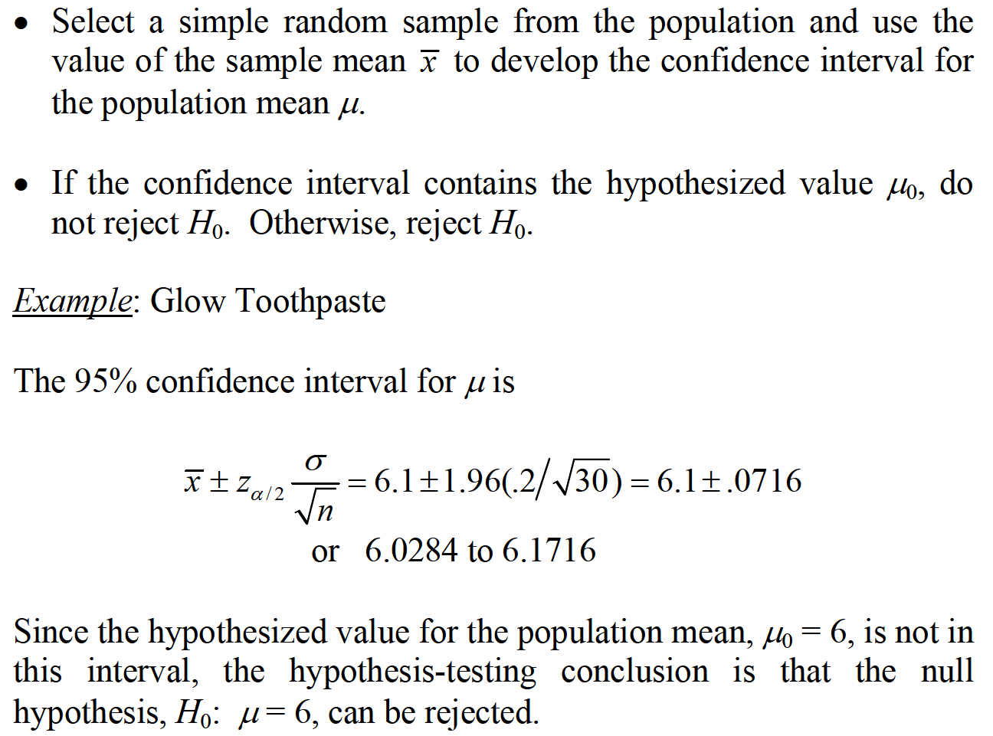
SINGLE SAMPLE

Slide 20

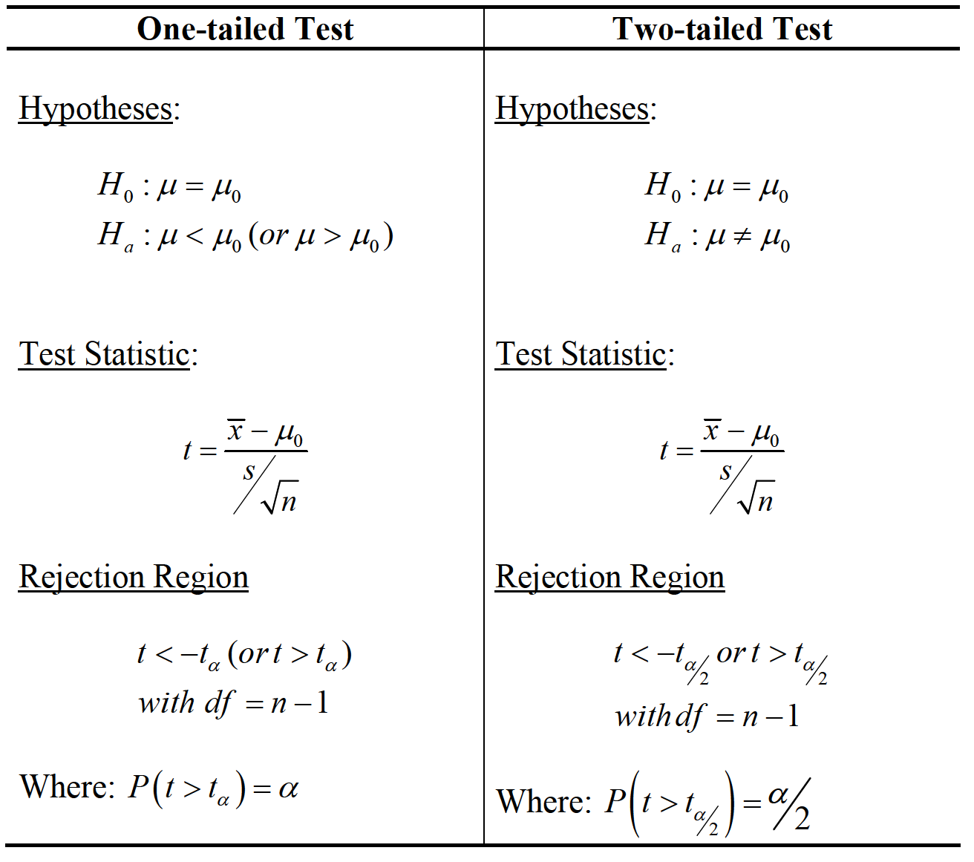
SINGLE SAMPLE

Slide 21

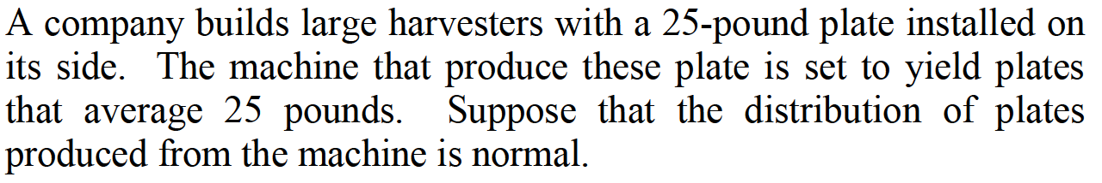
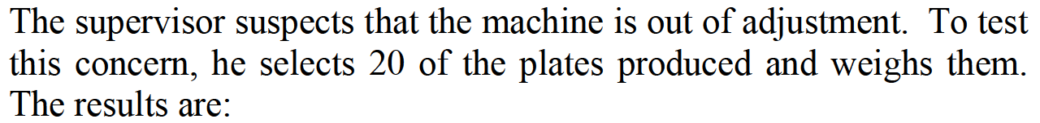
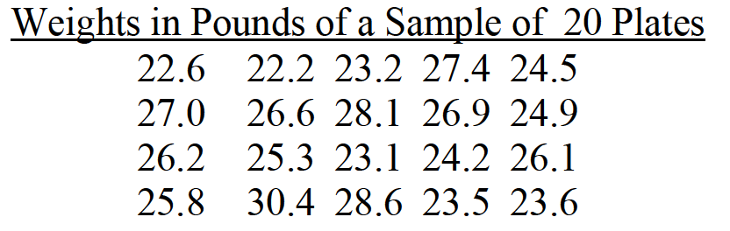

SINGLE SAMPLE

Slide 22
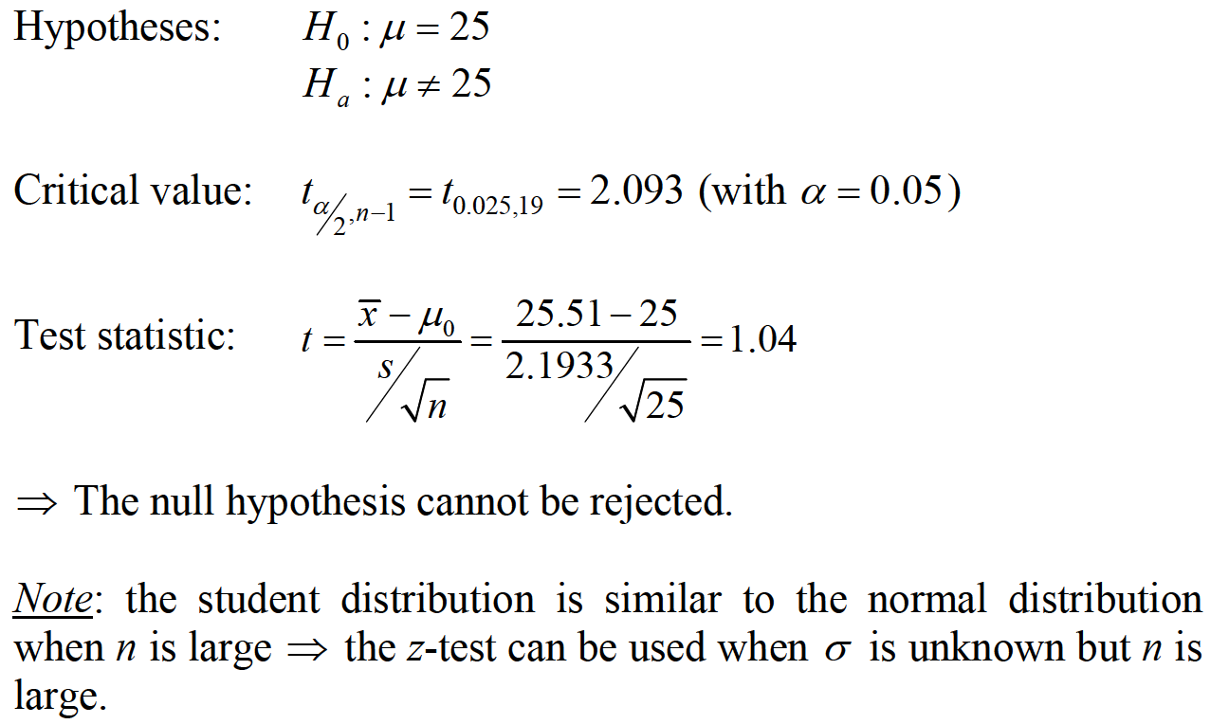
SINGLE SAMPLE

Slide 23

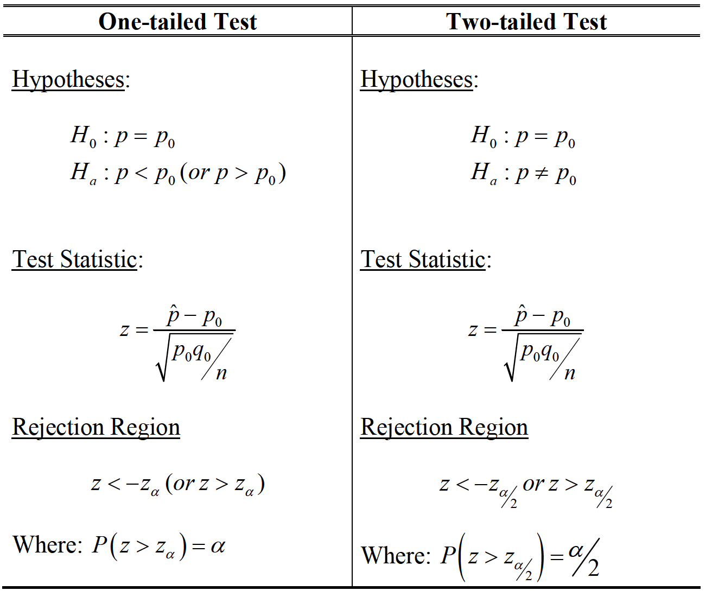
SINGLE SAMPLE

Slide 24
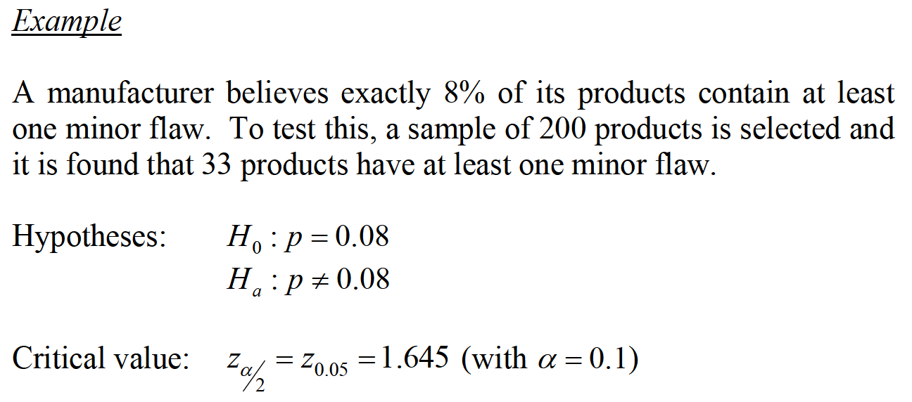
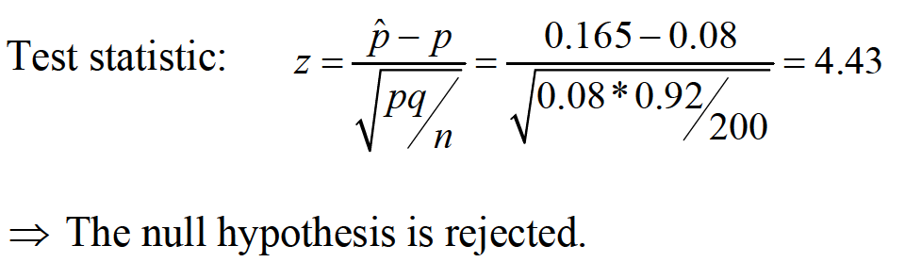
SINGLE SAMPLE

Slide 25

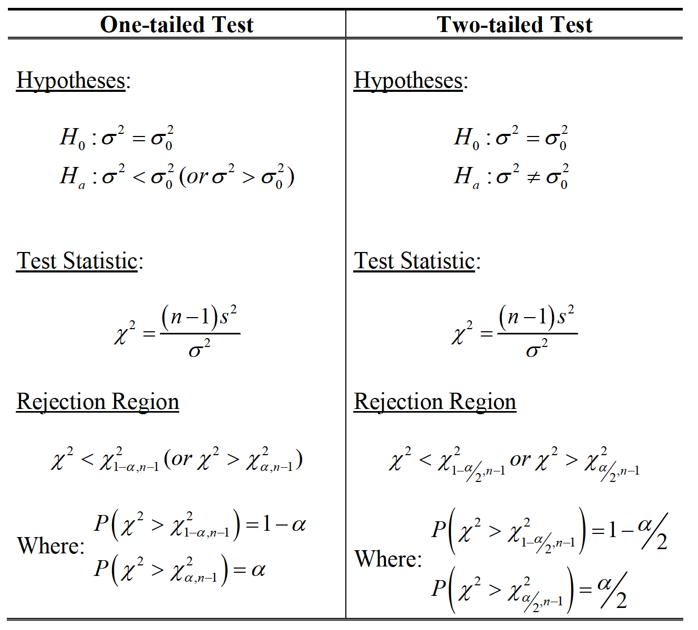
SINGLE SAMPLE

Slide 26

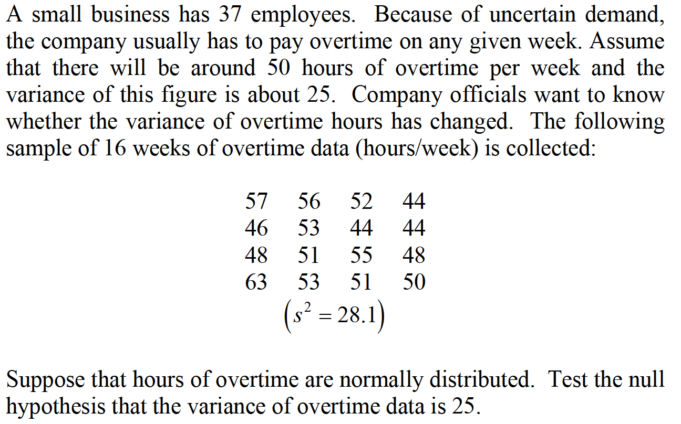
SINGLE SAMPLE

Slide 27
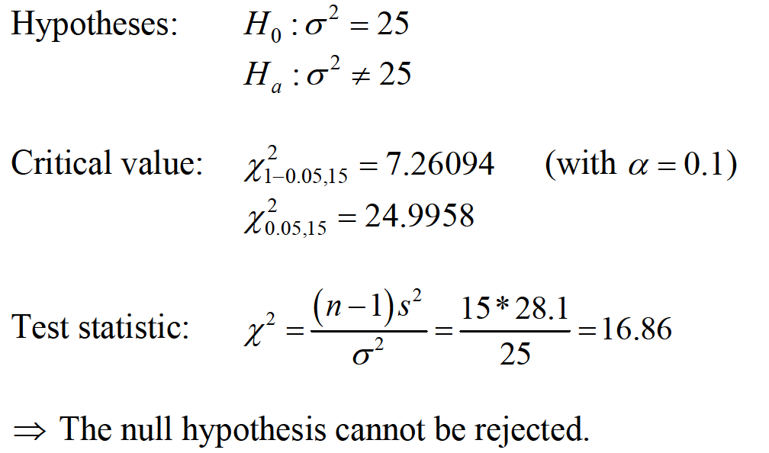
SINGLE SAMPLE

Slide 28
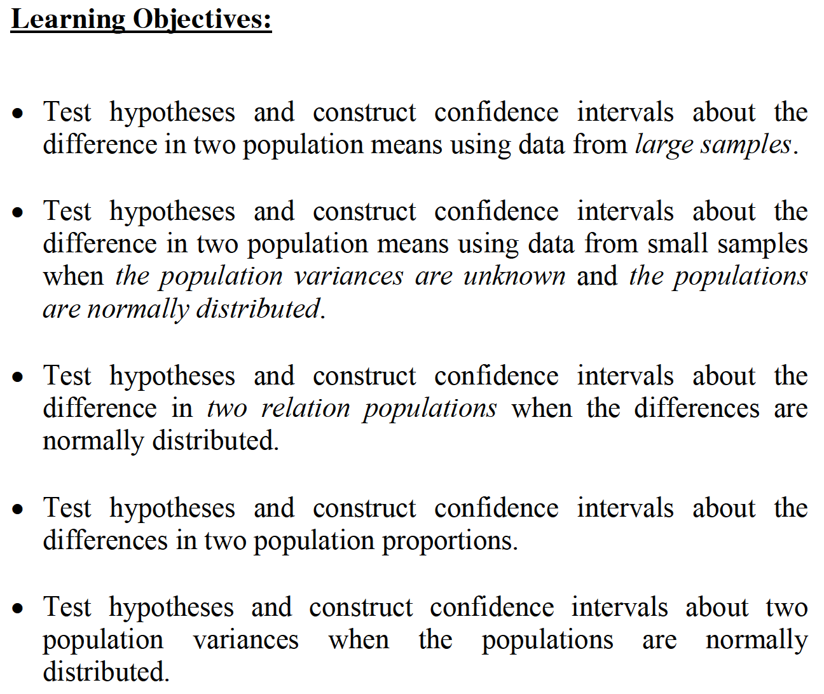
TWO SAMPLES

Slide 29
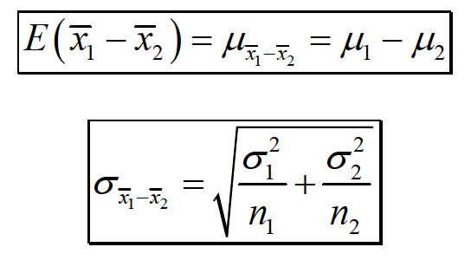
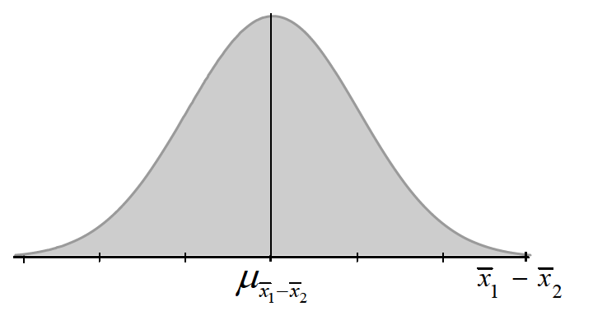
TWO SAMPLES

Slide 30
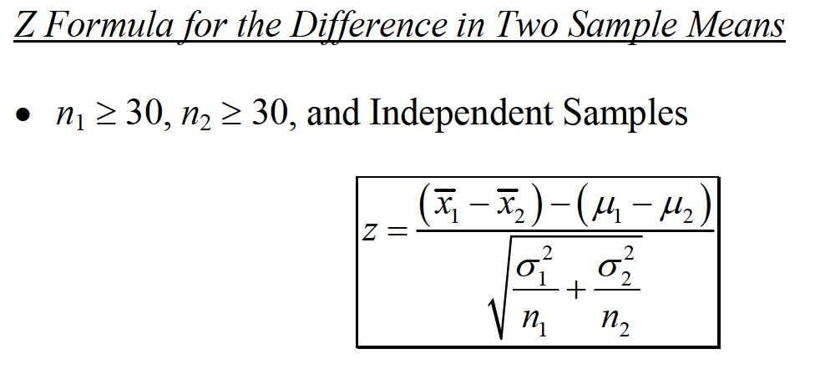
TWO SAMPLES

Slide 31

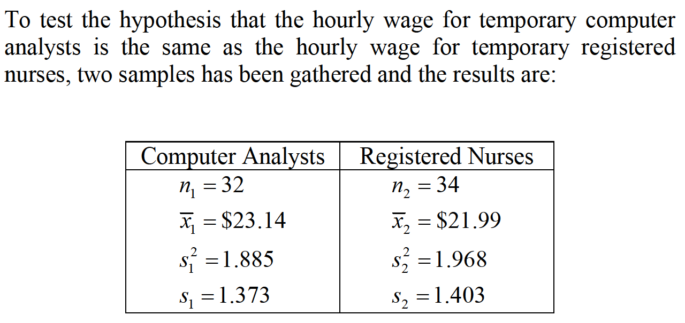
TWO SAMPLES

Slide 32
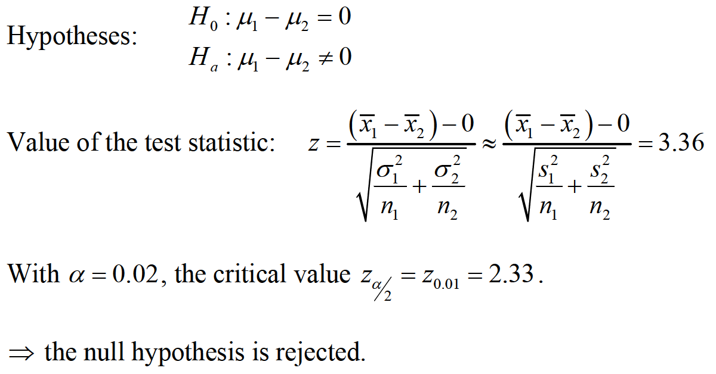
TWO SAMPLES

Slide 33
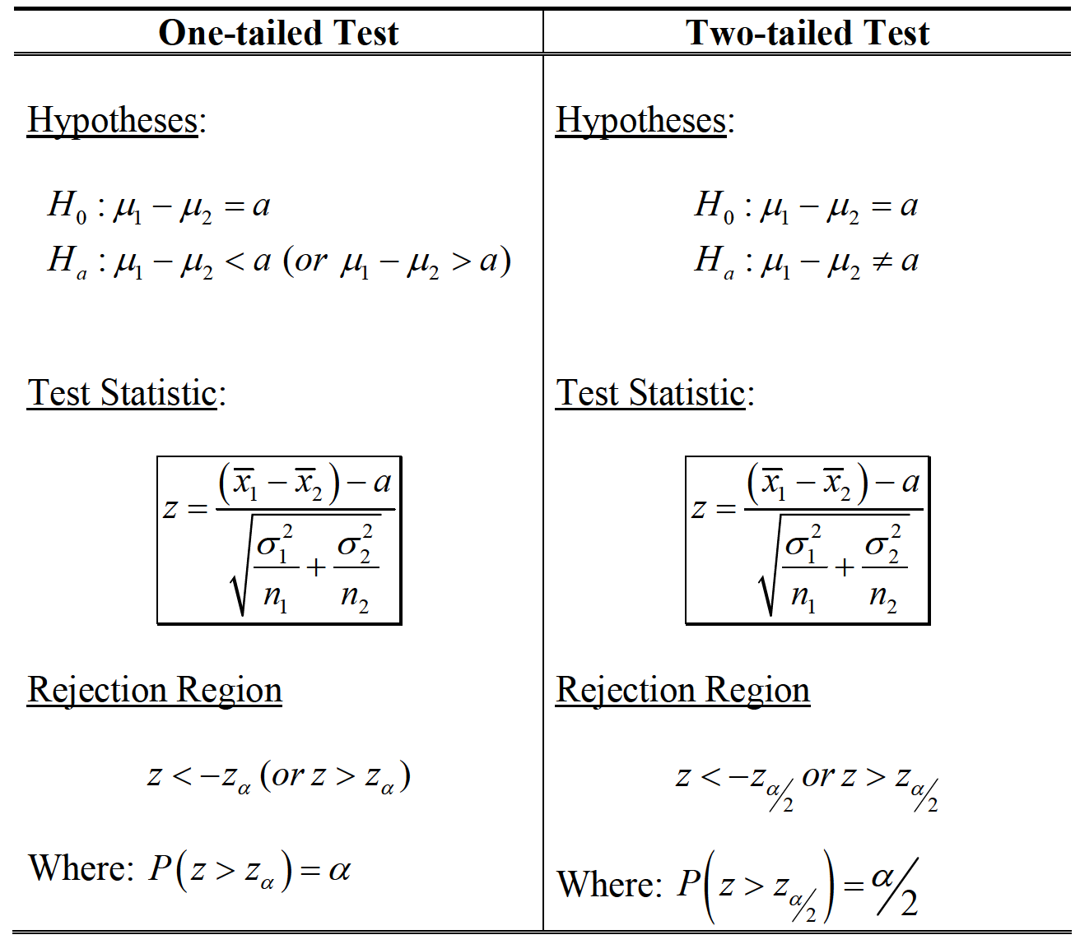
TWO SAMPLES

Slide 34
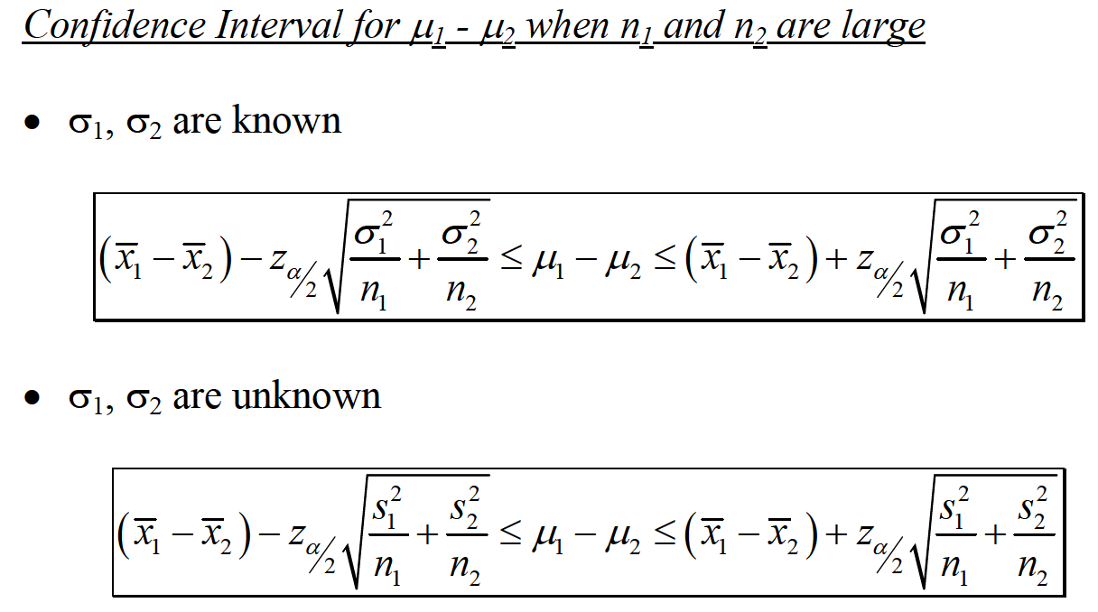
TWO SAMPLES

Slide 35
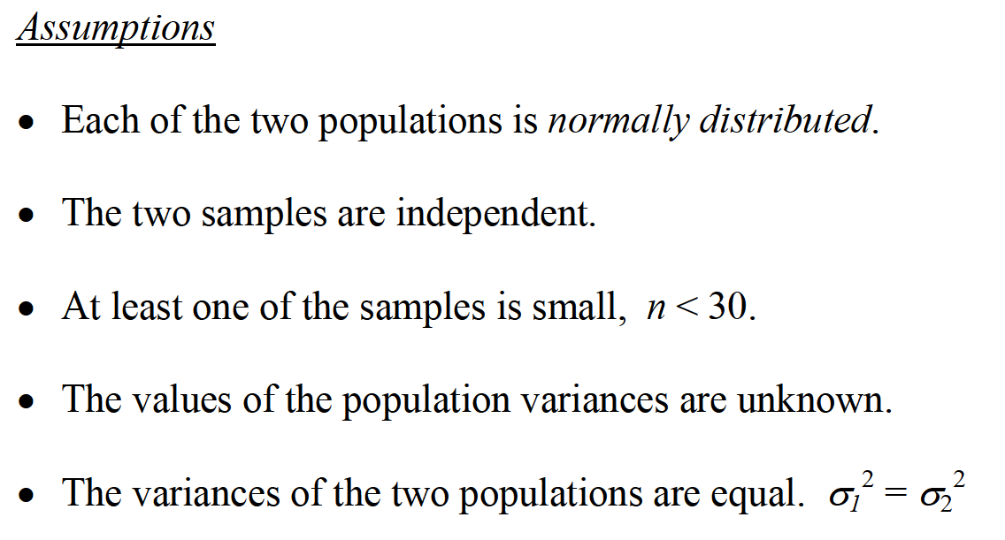
TWO SAMPLES

Slide 36
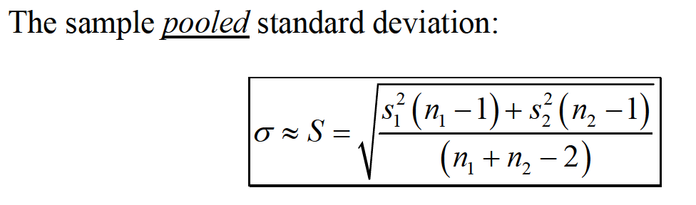
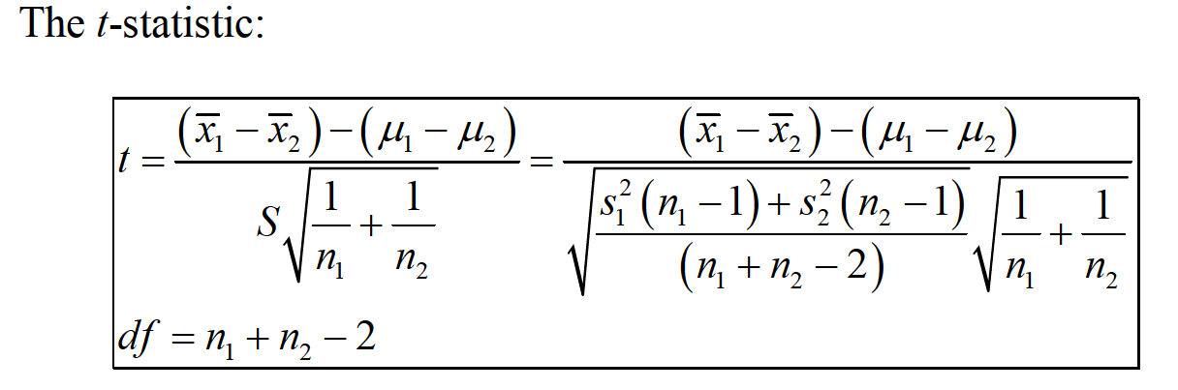
TWO SAMPLES

Slide 37
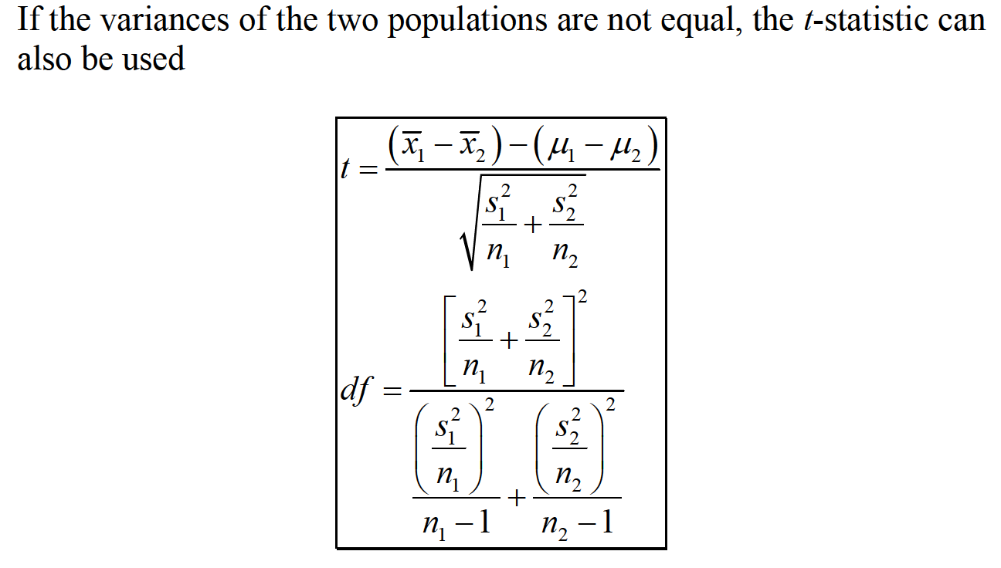
TWO SAMPLES

Slide 38

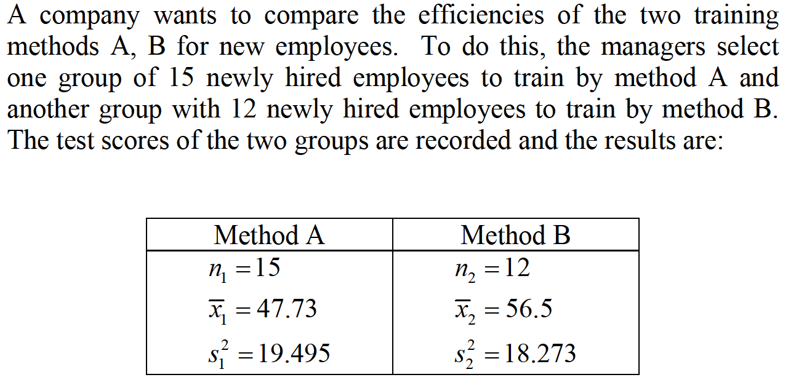
TWO SAMPLES

Slide 39
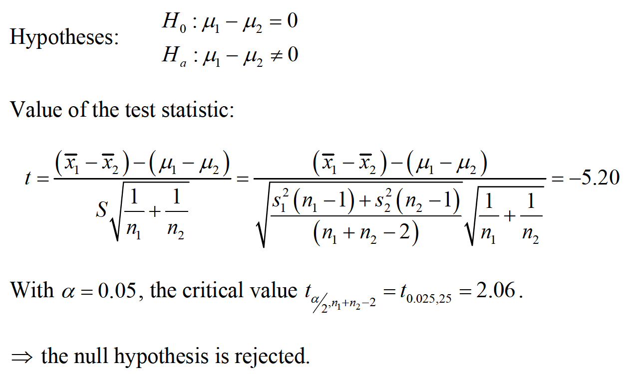
TWO SAMPLES

Slide 40
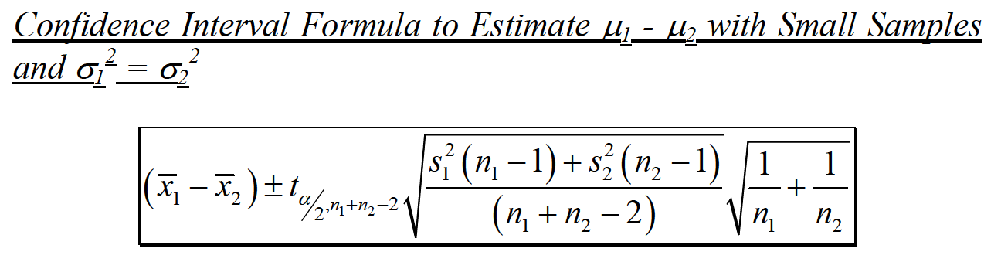
TWO SAMPLES

Slide 41
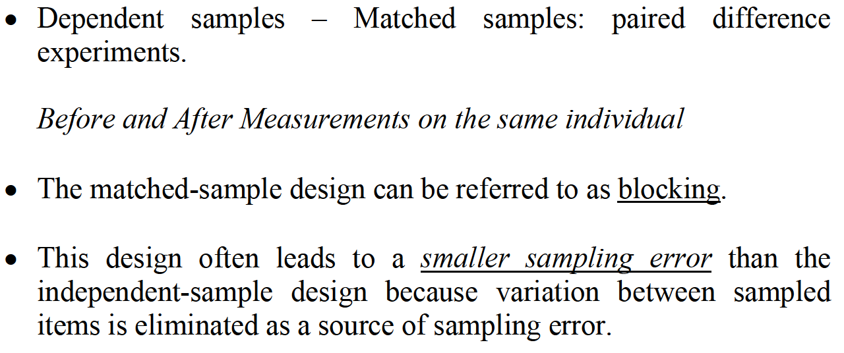
TWO SAMPLES

Slide 42
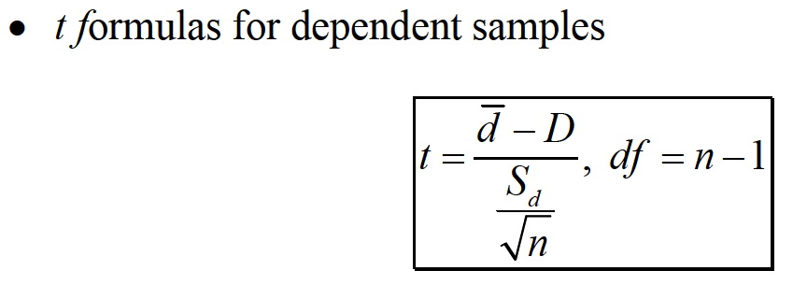
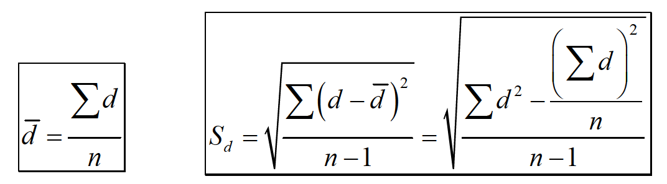
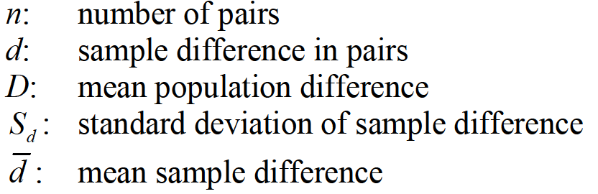
TWO SAMPLES

Slide 43

TWO SAMPLES

Slide 44

TWO SAMPLES

Slide 45

TWO SAMPLES

Slide 46

TWO SAMPLES

Slide 47


TWO SAMPLES

Slide 48


TWO SAMPLES

Slide 49

TWO SAMPLES

Slide 50

TWO SAMPLES

Slide 51

TWO SAMPLES

Slide 52

TWO SAMPLES

